Slide 1
Classical / Medieval / Renaissance
Art
California State Standards: 7.8.1, 7.8.5

Slide 2
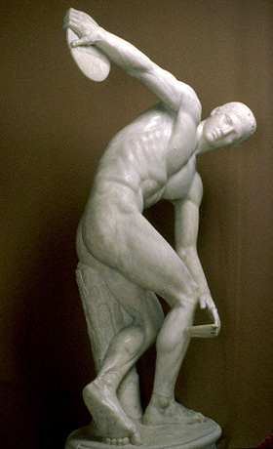
Classical

Slide 3
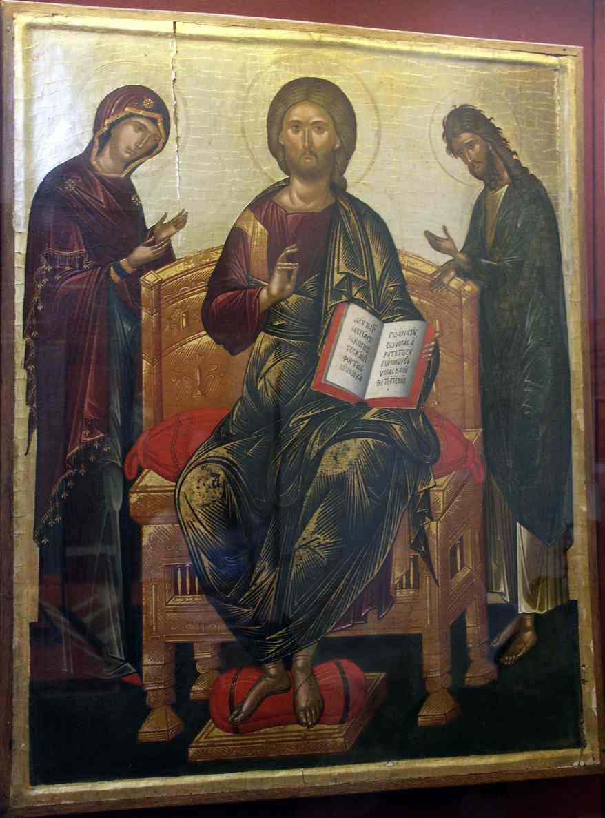
Medieval

Slide 4
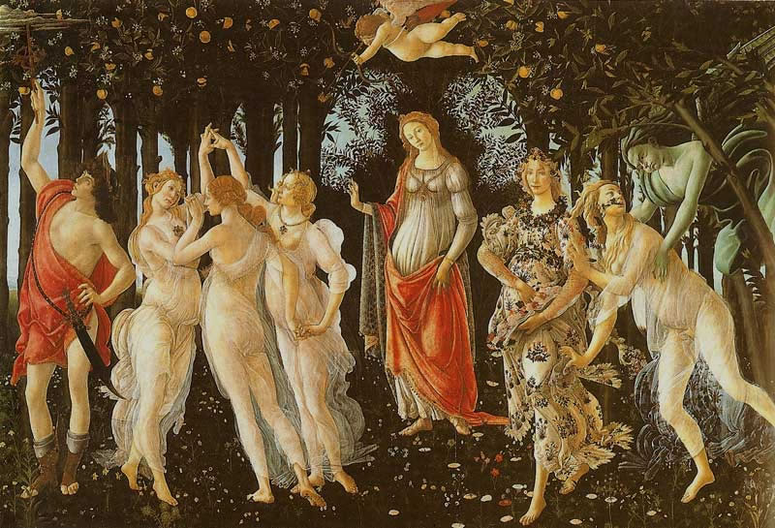
Renaissance

Slide 5
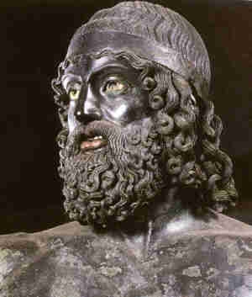
Now it is your turn

Slide 6
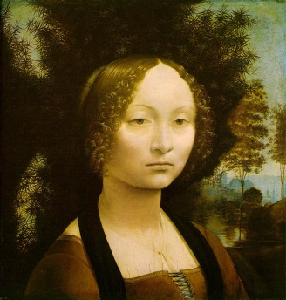
Classical/Medieval/Renaissance?

Slide 7
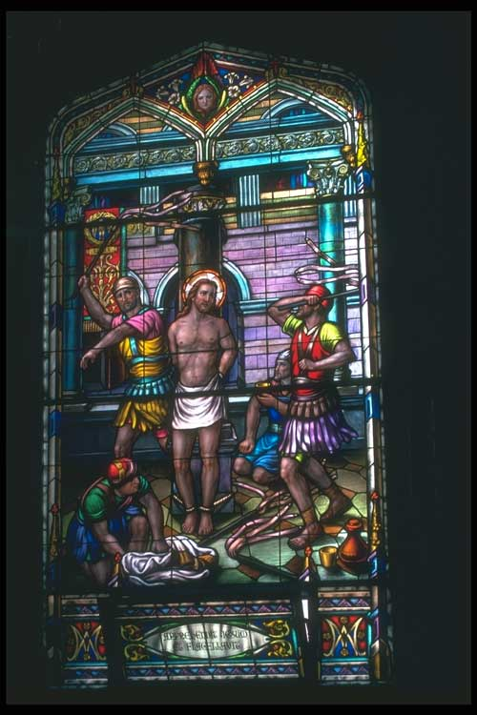
Classical/Medieval/Renaissance?

Slide 8

Classical/Medieval/Renaissance?

Slide 9
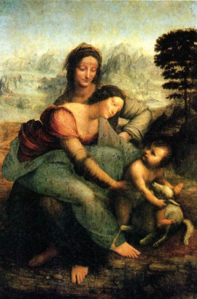
Classical/Medieval/Renaissance?

Slide 10
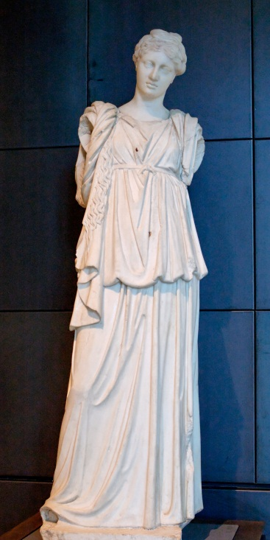
Classical/Medieval/Renaissance?

Slide 11
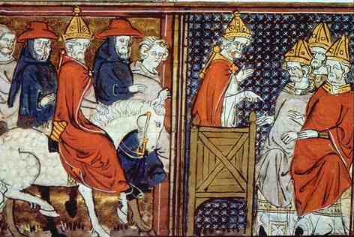
Classical/Medieval/Renaissance?

Slide 12
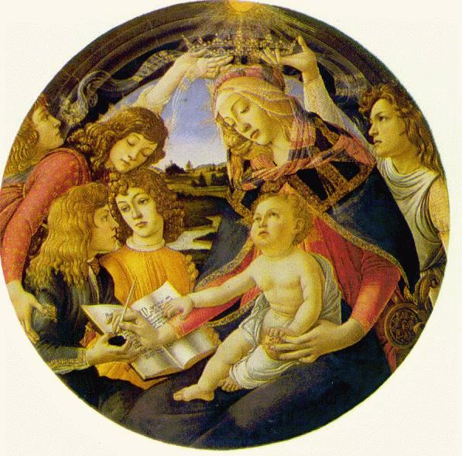
Classical/Medieval/Renaissance?

Slide 13
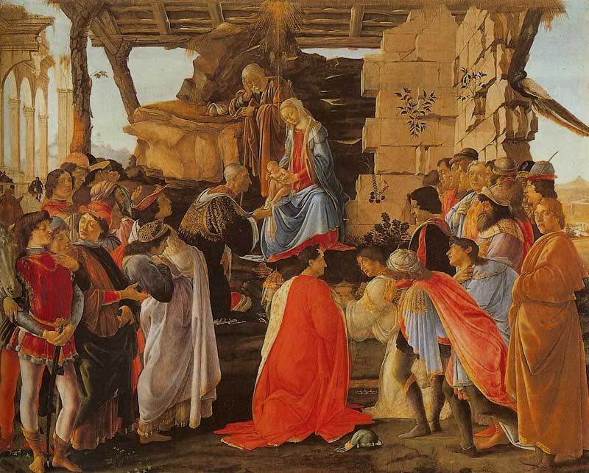
Classical/Medieval/Renaissance?

Slide 14
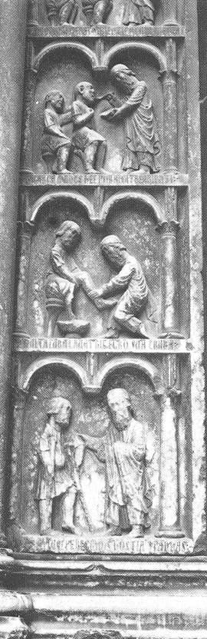
Classical/Medieval/Renaissance?

Slide 15
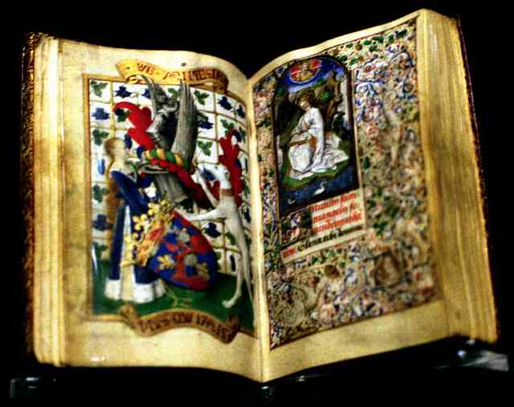
Classical/Medieval/Renaissance?

Slide 16
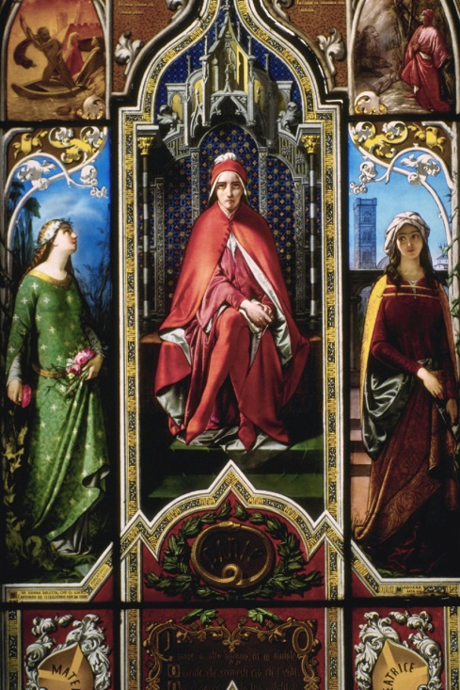
Classical/Medieval/Renaissance?

Slide 17
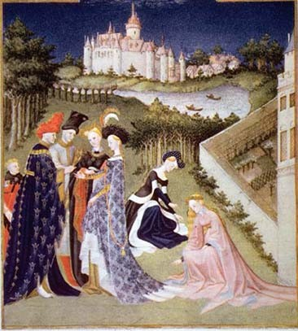
Classical/Medieval/Renaissance?

Slide 18
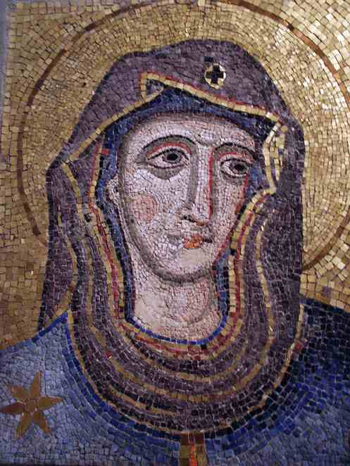
Classical/Medieval/Renaissance?

Slide 19
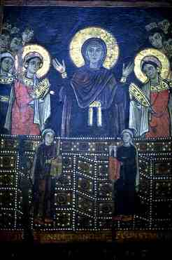
Classical/Medieval/Renaissance?

Slide 20
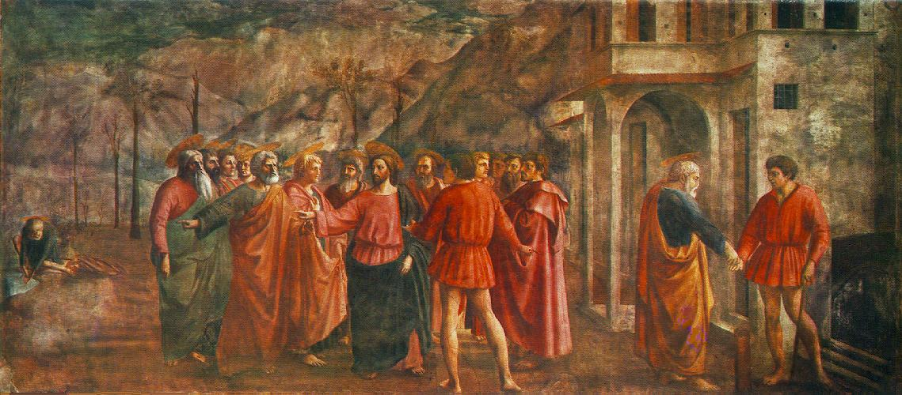
Classical/Medieval/Renaissance?

Slide 21
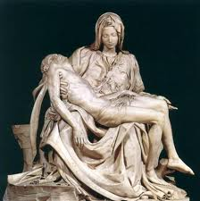
Classical/Medieval/Renaissance?

